Slide 1

Web Scraping and Data visualization
Programming for Data Science
Students:
Gabriel-Cosmin Bolbotină
Francesco Della Valle
Jan Durinec
Gaetano Saviano
Sajipan Sivatheesan

Slide 2
Table of Contents
Introduction and chosen topic
Data collection
Web scraping
Creating the datasets
Data visualization
Tools used for data visualization
Results
Conclusion

Slide 3
Chosen topic:
Cars, cars, cars
We looked for information regarding car details, such as:
Mileage
Production Year
Manufacturer
Price
Combustion type or the condition
We gathered informations about different cars by web scraping the website heycar.com/uk

Slide 4


Data Collection

Slide 5
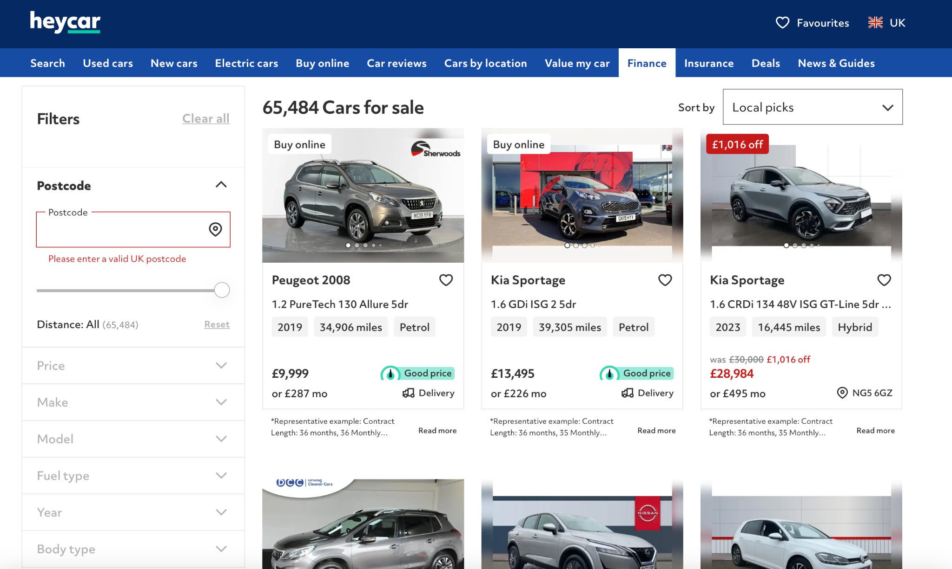
heycar.com/uk

Slide 6


Slide 7
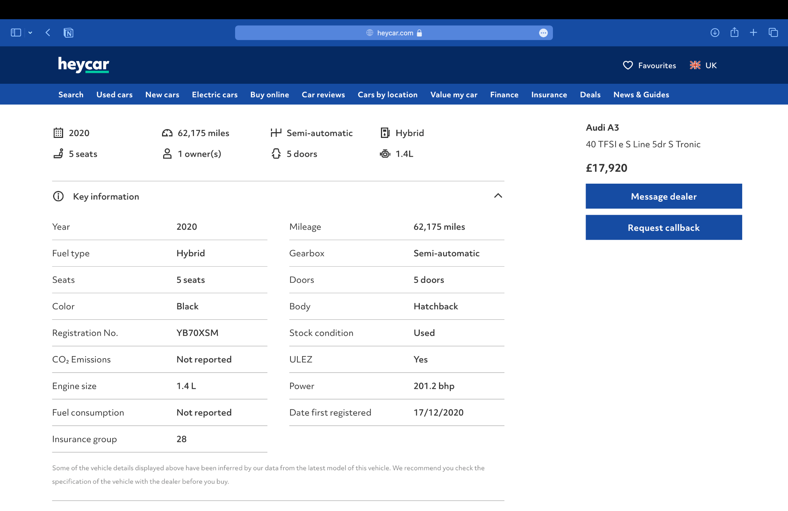
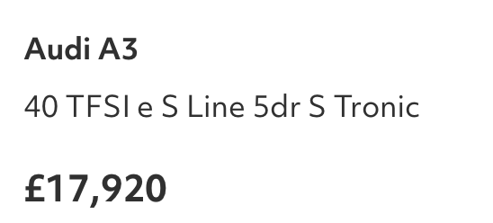
Scraped information into the csv file:
Name: Audi A3
Type: 40 TFSI e S Line
Mileage: 62,175 miles
Year: 2020
Condition: Hybrid
Price: 17,920

Slide 8
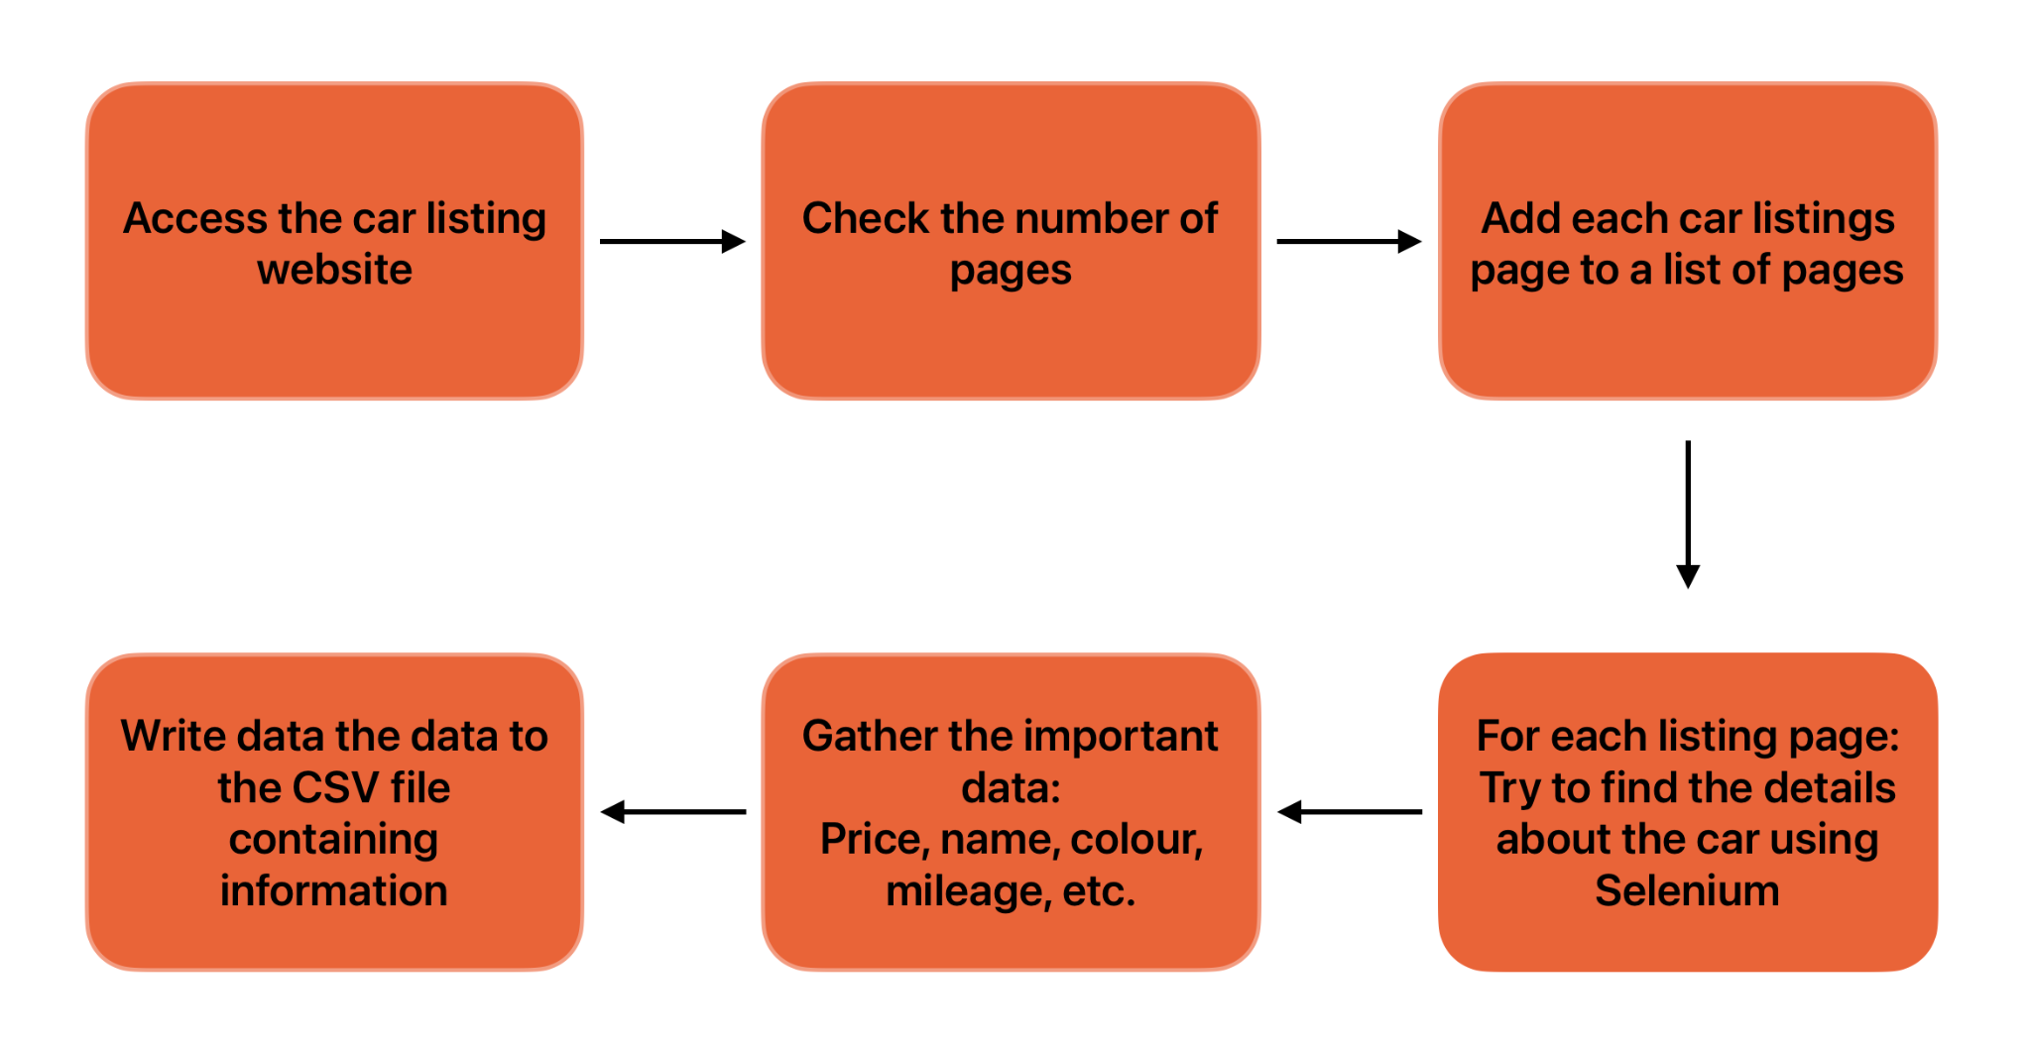
How is the data scraped? The Idea
Notes:
Explaining the idea: First we wanted to find the dynamic page with publicly available information, then hardcoding the filters (such as car brand), scrap the data using the selenium with firefox web driver and additional libraries such as csv - for creating and handling csv files and bs4 - Beautiful Soup is a library that makes it easy to scrape information from web pages. It sits atop an HTML or XML parser, providing Pythonic idioms for iterating, searching, and modifying the parse tree
And in the end, we want to save all data in csv format so we can use it for the other part of this assignment

Slide 9
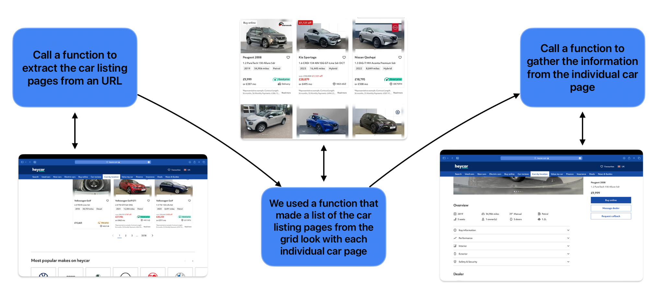
How is the data scrapped? The script
Notes:
Explain the script:
We hardcoded the base url where the car mark audi, so the script loads the webpage and accepts the cookies - it automatically clicks the button.
One of the first things it does is finding the maximum number of pages in order to scrap the data from all the pages. After it, the script scraps 6 resources from the 18 different cars from the current page. Next, it loads the second page where it does the same. Before saving the data into a csv file, the script process the data like removing not a number values, converting string to float, removing pound symbol from the price and so on… After some time, the script makes csv file with all the data separated in 6 rows and 5 thousand columns which is perfect for the further analysis and data visualization.

Slide 10
Generated data

Slide 11
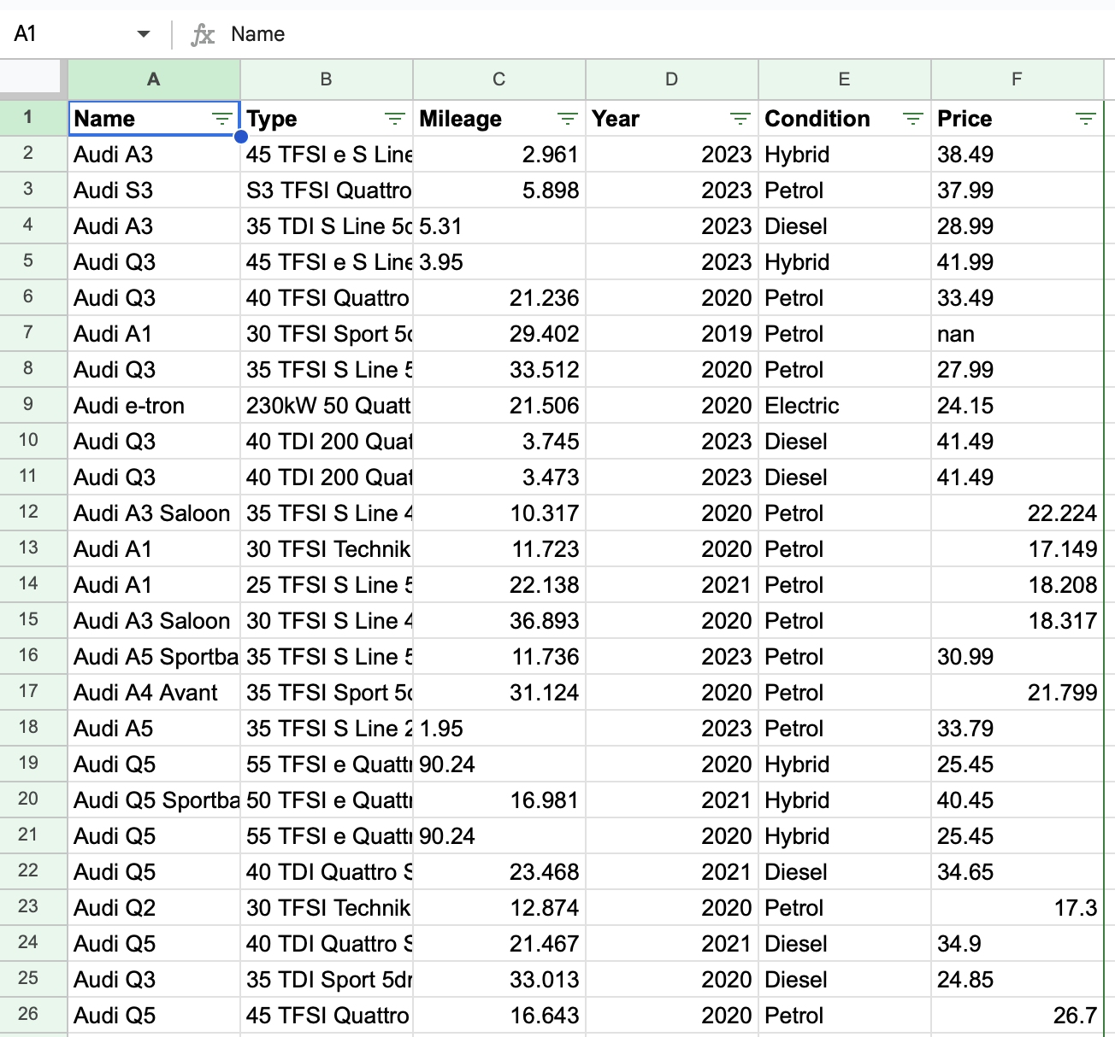
The csv file contains the following information about Audi cars:
Name
Mileage
Type
Year
Condition
Price
Notes:
This is our csv file with the raw data, we can see our 6 features - Name, Type, Mileage, Year, Condition, Price
And now I’m gonna let my colleagues speak about data vizualization part

Slide 12

Data Visualization

Slide 13
What is to be analysed using the Input Data?
How does the price differ for different car models?
Is there a correlation between the mileage and the price of the cars?
Do price distributions vary across car conditions (drive types)?
How have the prices of hybrid, petrol and diesel cars changed over time?
Which cars offer the best value for money considering their price and mileage?

Slide 14



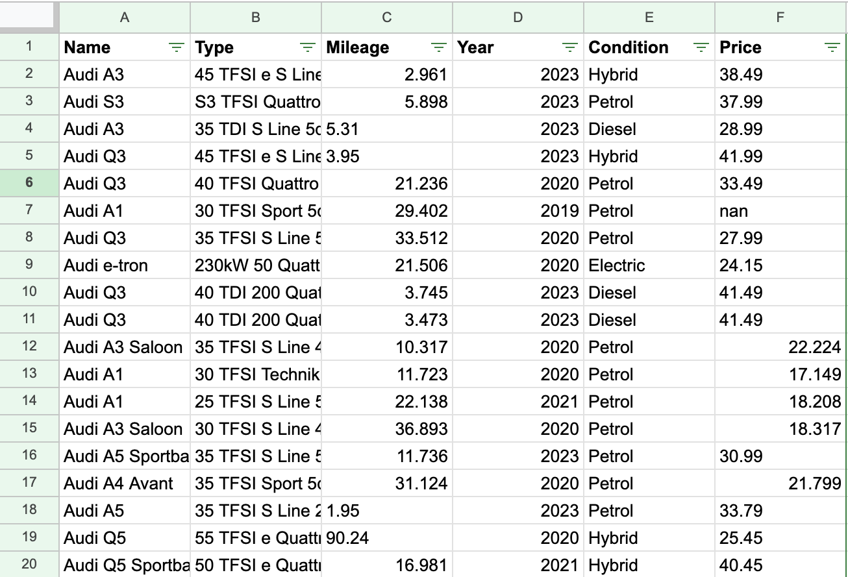
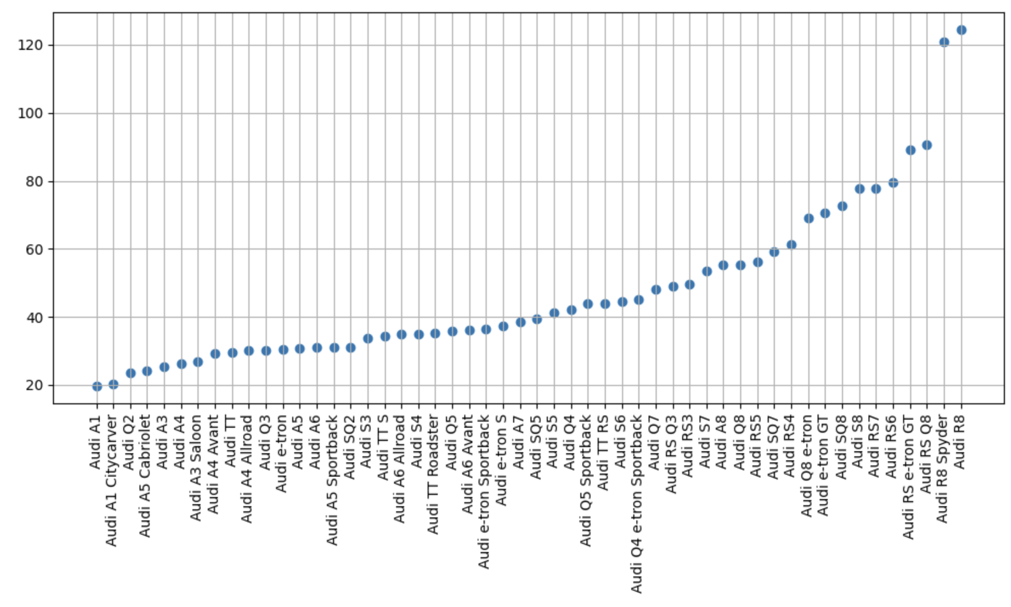
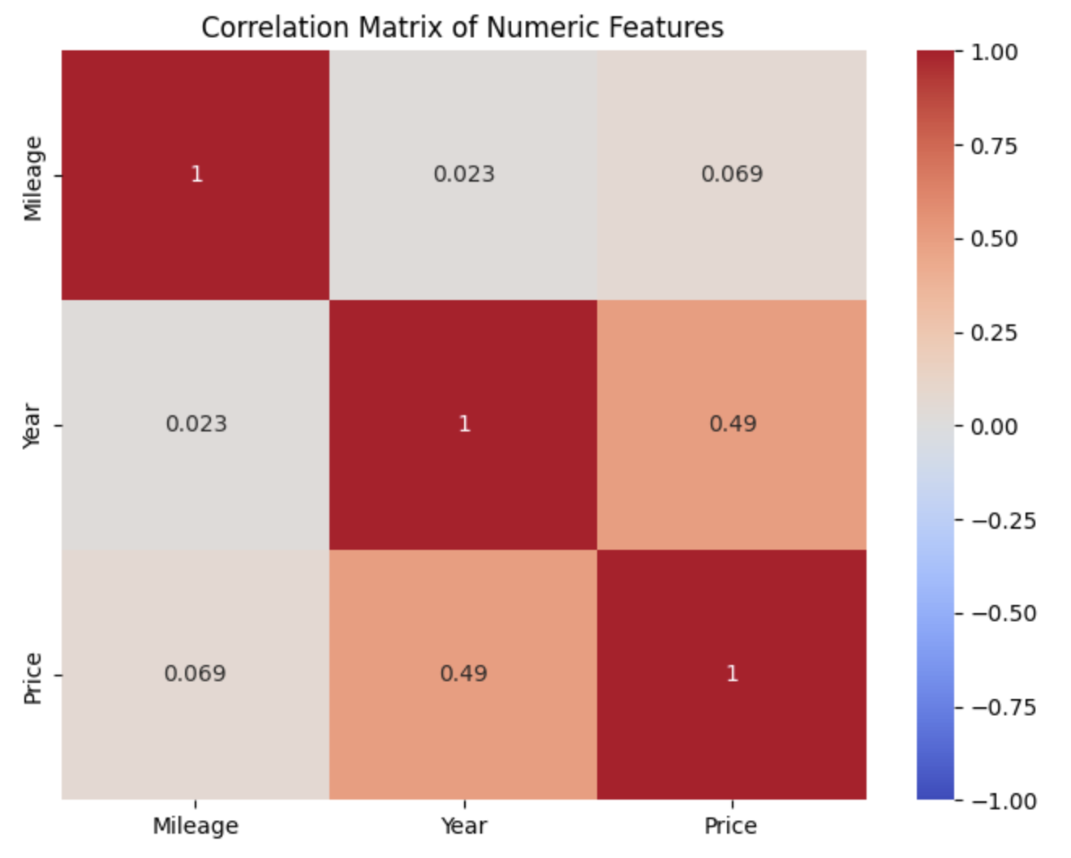
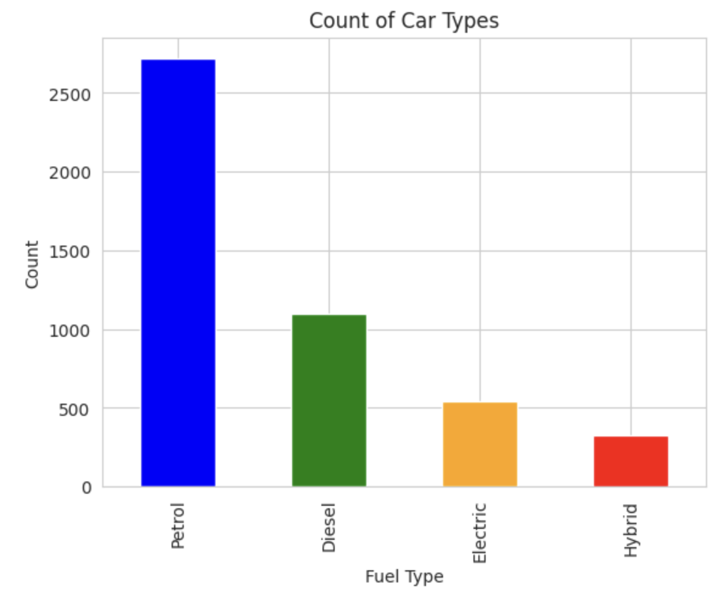
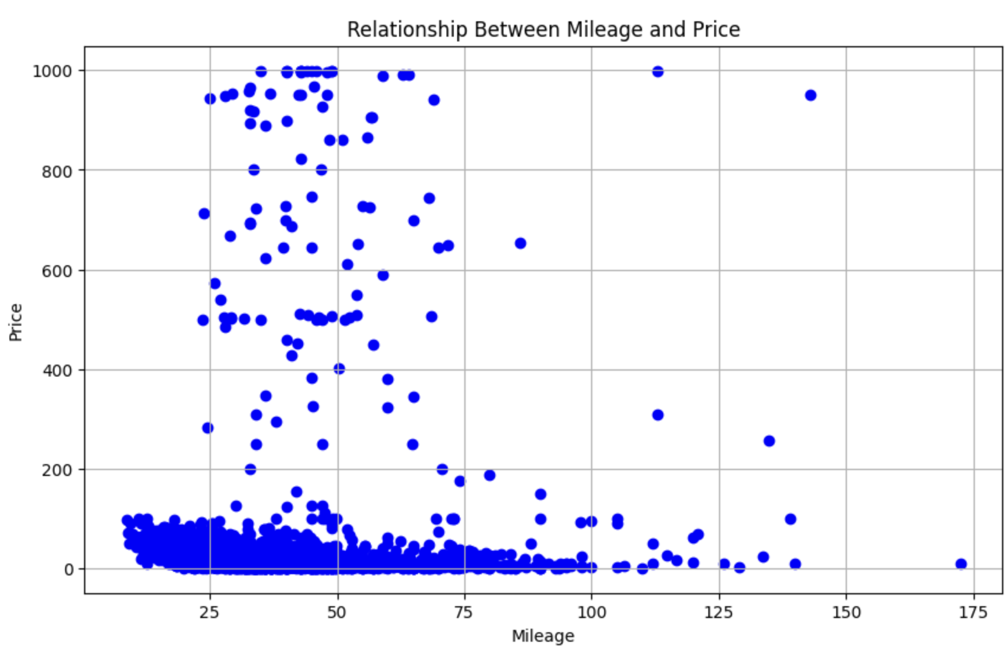
Data Treatment and Methods used
Raw Data
Data Visualization
Data Transformation & Wrangling
Filtering Null Values
Grouping and Aggregation
Calculation of Metrics
Identification of Outliers
Interactive Filtering

Slide 15
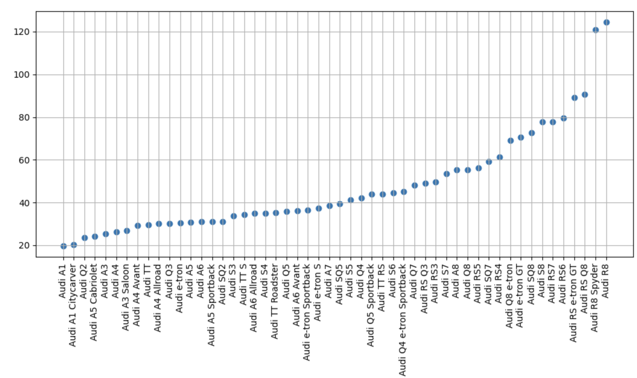
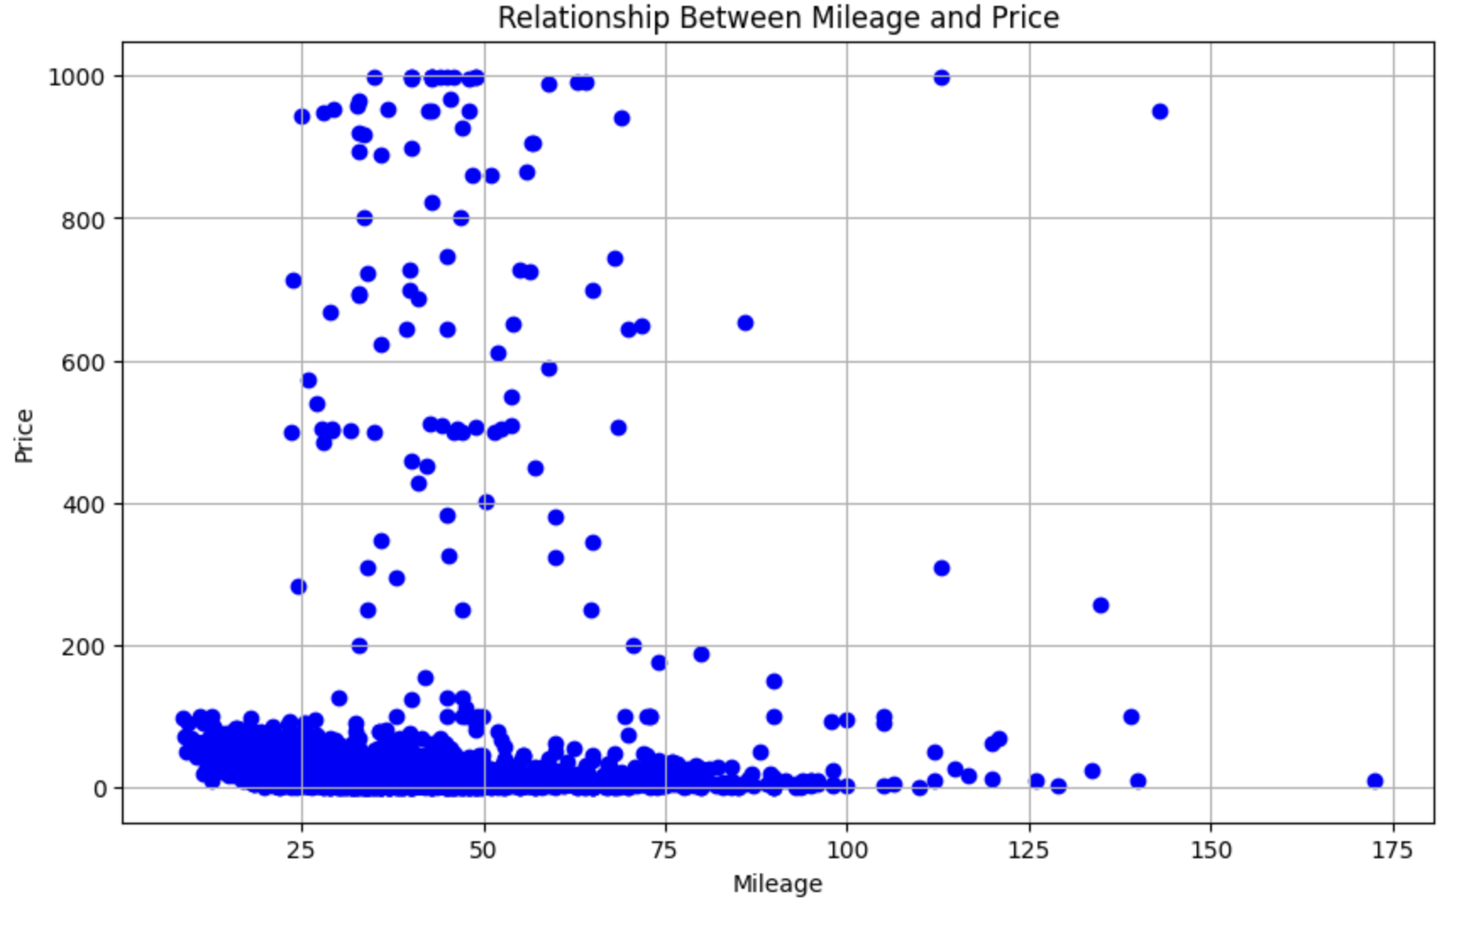
Transformed Data Insights: Visualizing Key Queries
How does the price differ for different car models?
Is there a correlation between the mileage and the price of the cars?
The priciest car identified is the Audi R8, while the most affordable option is the Audi A1.
Unexpected correlation: Higher mileage typically correlates with lower prices, but given that all cars are relatively new, this trend is disrupted.

Slide 16
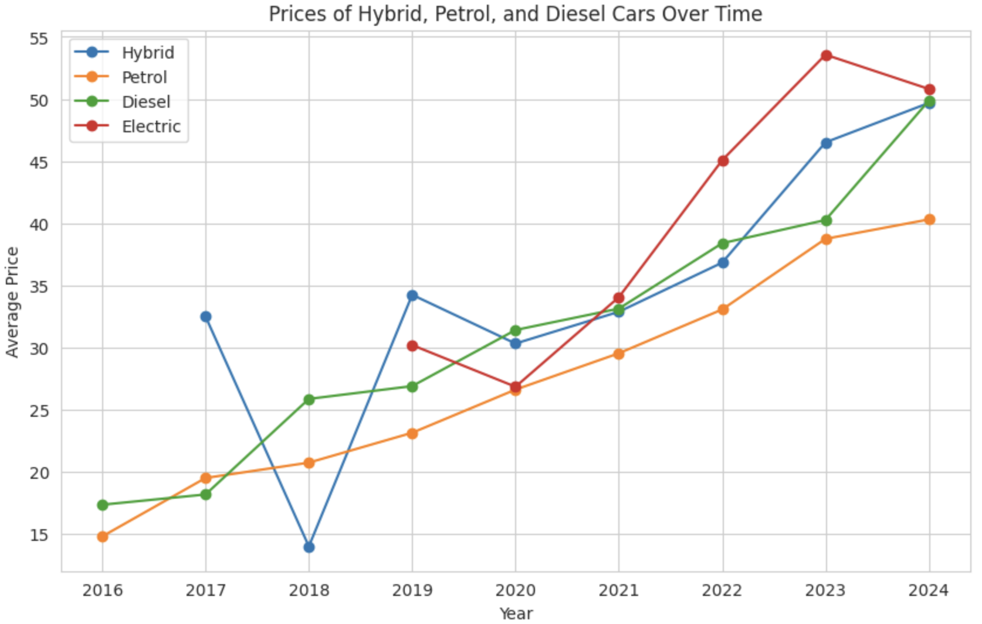
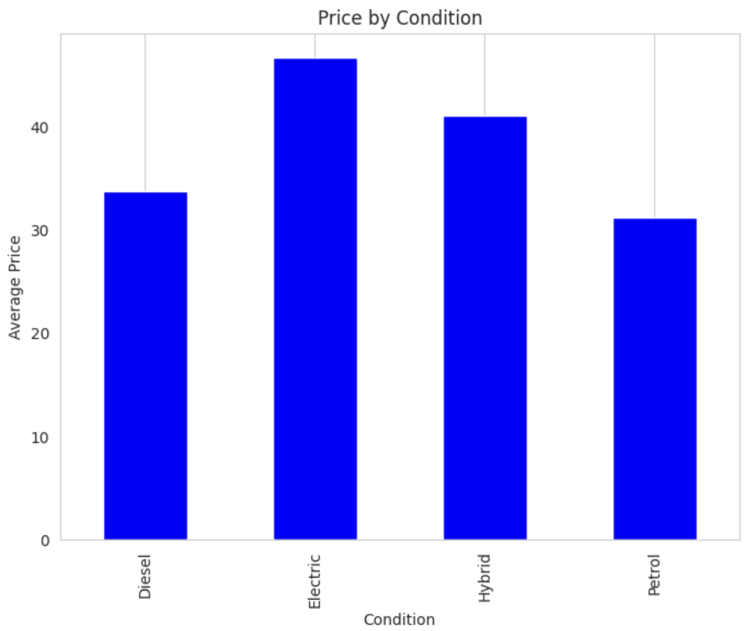
Transformed Data Insights: Visualizing Key Queries
How have the prices of hybrid, petrol and diesel cars changed over time?
Do price distributions vary across car conditions (drive types)?
We observe a general upward trend in prices across all car types over the period. Electric cars experienced a relatively rapid increase, while petrol cars showed a steady rise in prices.
Electric cars have the highest average price, while petrol cars are the most affordable.

Slide 17
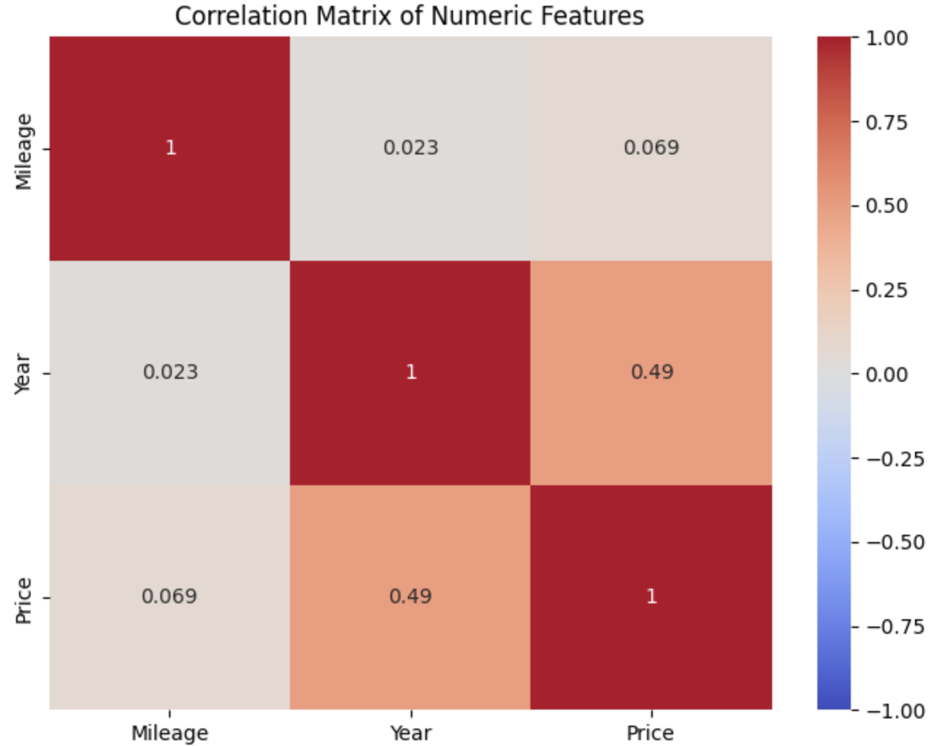
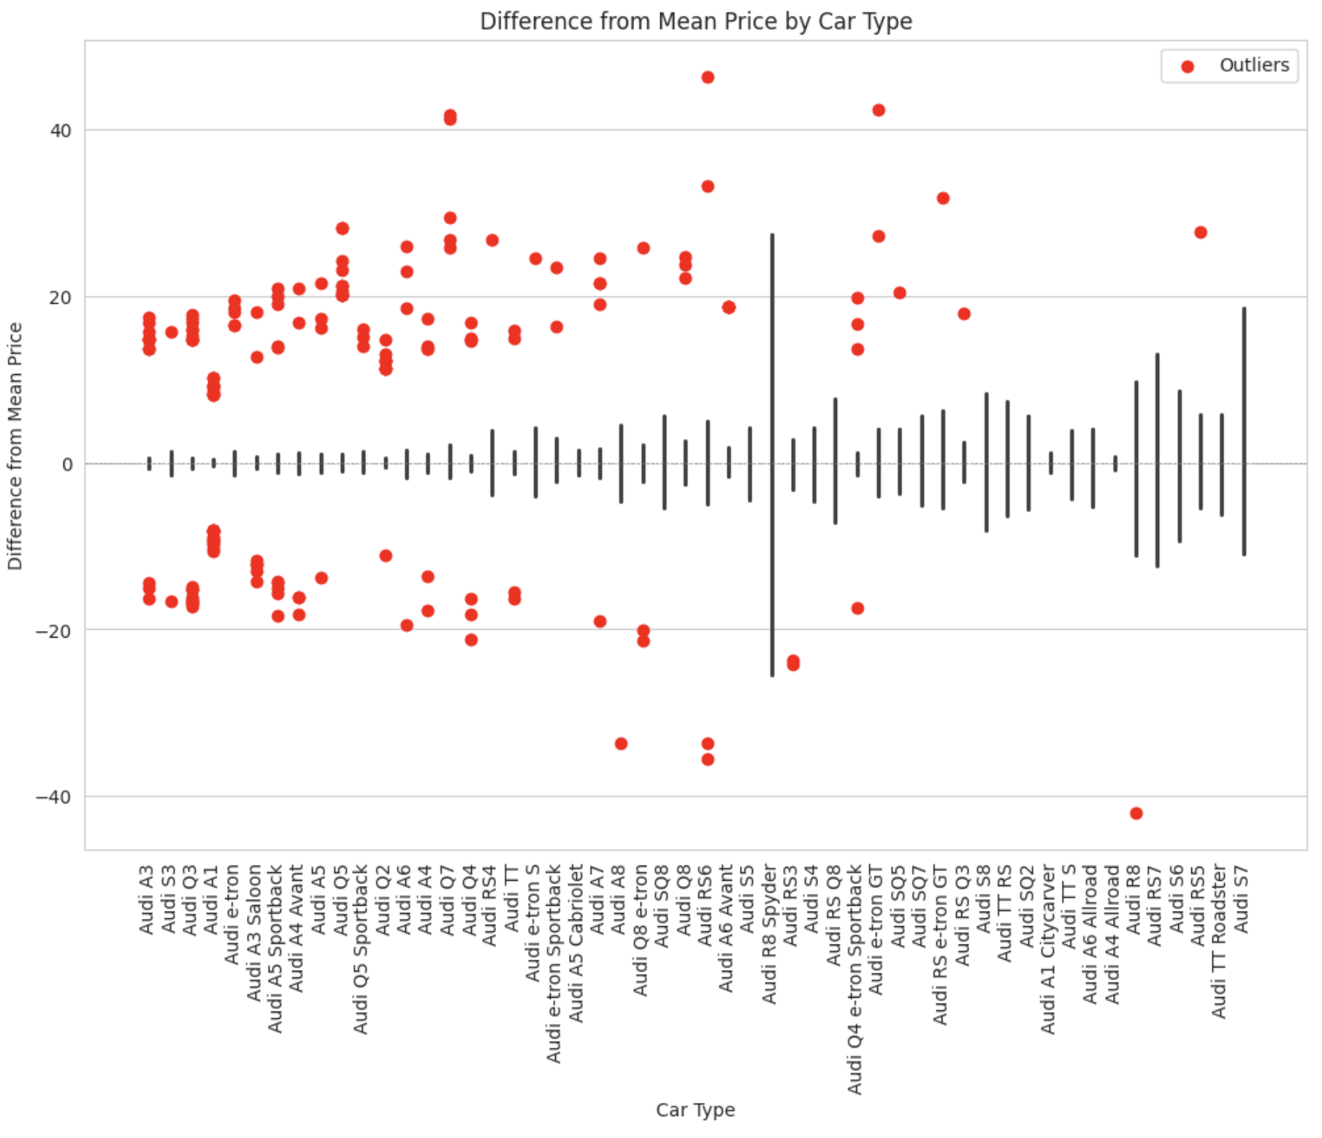
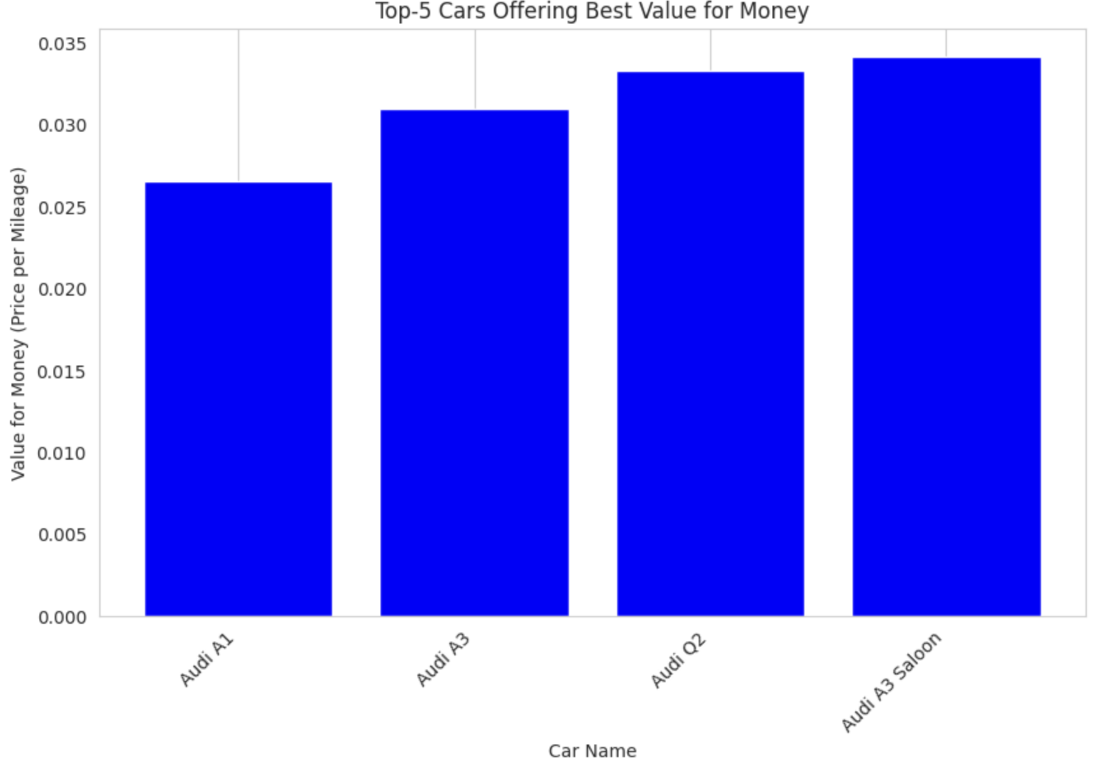
Transformed Data Insights: Visualizing Key Queries
Which cars offer the best value for money considering their price and mileage?
Further insights and additional diagrams in the final script provide detailed answers to the previously formulated questions, but including them here would exceed the scope of this presentation.
By calculating a value-for-money metric as the price-to-mileage ratio (lower indicating better value), Audi A1 emerges as the top choice.

Slide 18
Conclusion

Slide 19
Conclusion
We have learnt to:
Use Python tools for performing web scraping
Analyze websites in order to get the needed information
Formulate and answer questions about the generated data
Create rich data visualization diagrams and plots.

Slide 20
Thank you!
Cars
Cars
Cars
Cars
Cars
Cars
Cars
Cars
Cars
Cars
Cars
Cars

Slide 21
References
https://selenium-python.readthedocs.io/
https://heycar.com/uk
https://pypi.org/project/beautifulsoup4/
https://pypi.org/project/pandas/
https://pypi.org/project/matplotlib/
https://medium.com/analytics-vidhya/web-scraping-with-python-beginner-to-advanced-10daaca021f3
https://pypi.org/project/seaborn/

